Slide 1


Aafreen Moyal
SALES INSIGHTS
To increase Profit
01

Slide 2

INTRODUCTION
Defining the Problem
A prominent supplier of computer hardware and peripherals, operates across multiple regions in India with various regional offices serving a diverse clientele.
The company faces challenges due to fragmented sales data collected separately by regional offices.
The Sales Director struggles to obtain comprehensive and real-time sales insights across all locations.
02

Slide 3
SOLUTIONS
Manual consolidation of sales data
Automating data collection
Absence of a centralized platform
Unified platform
Actionable insights for decision-making.
Real-time dashboards
Quick responses to market trends
Dynamic visualizations and up-to-date data
03

Slide 4
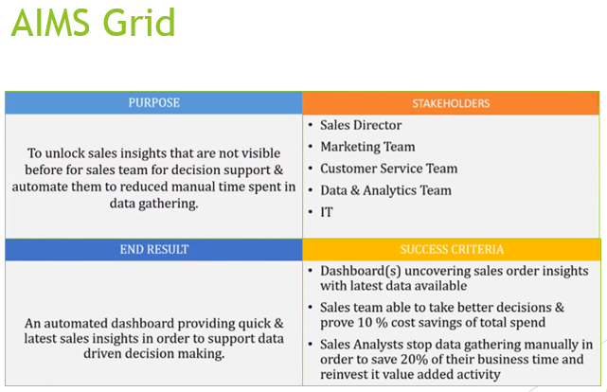
04

Slide 5








APPROACH
Data Discovery
Data Cleaning
Data Merging
Generating Dashboards
Gaining Insight
05

Slide 6
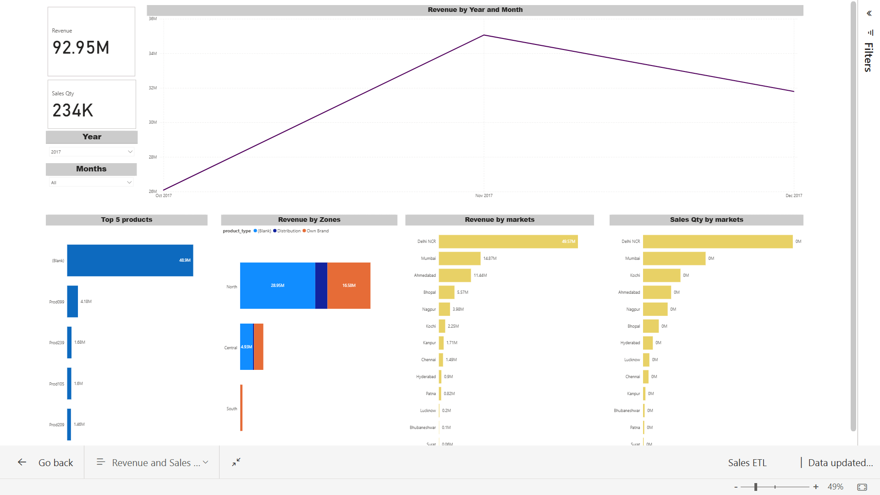

Slide 7


Slide 8


Slide 9
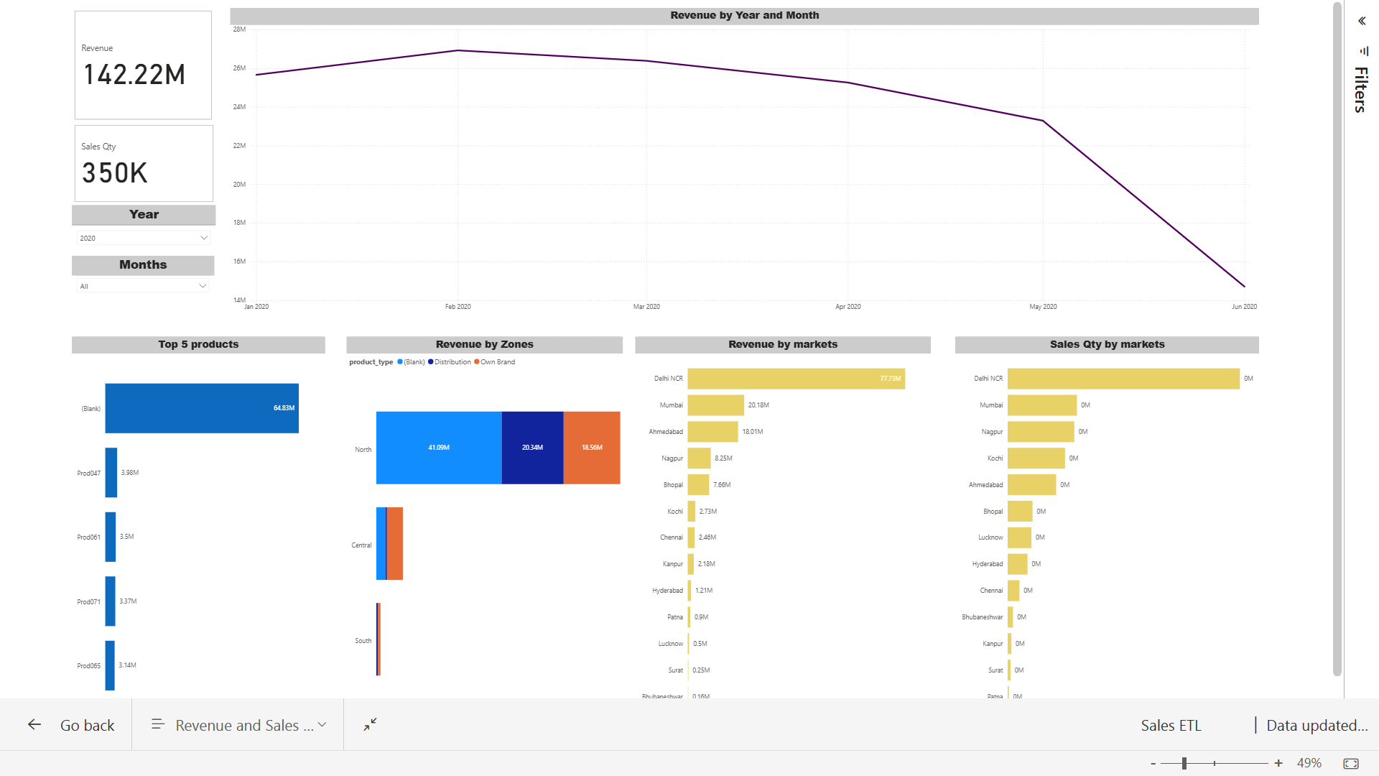

Slide 10
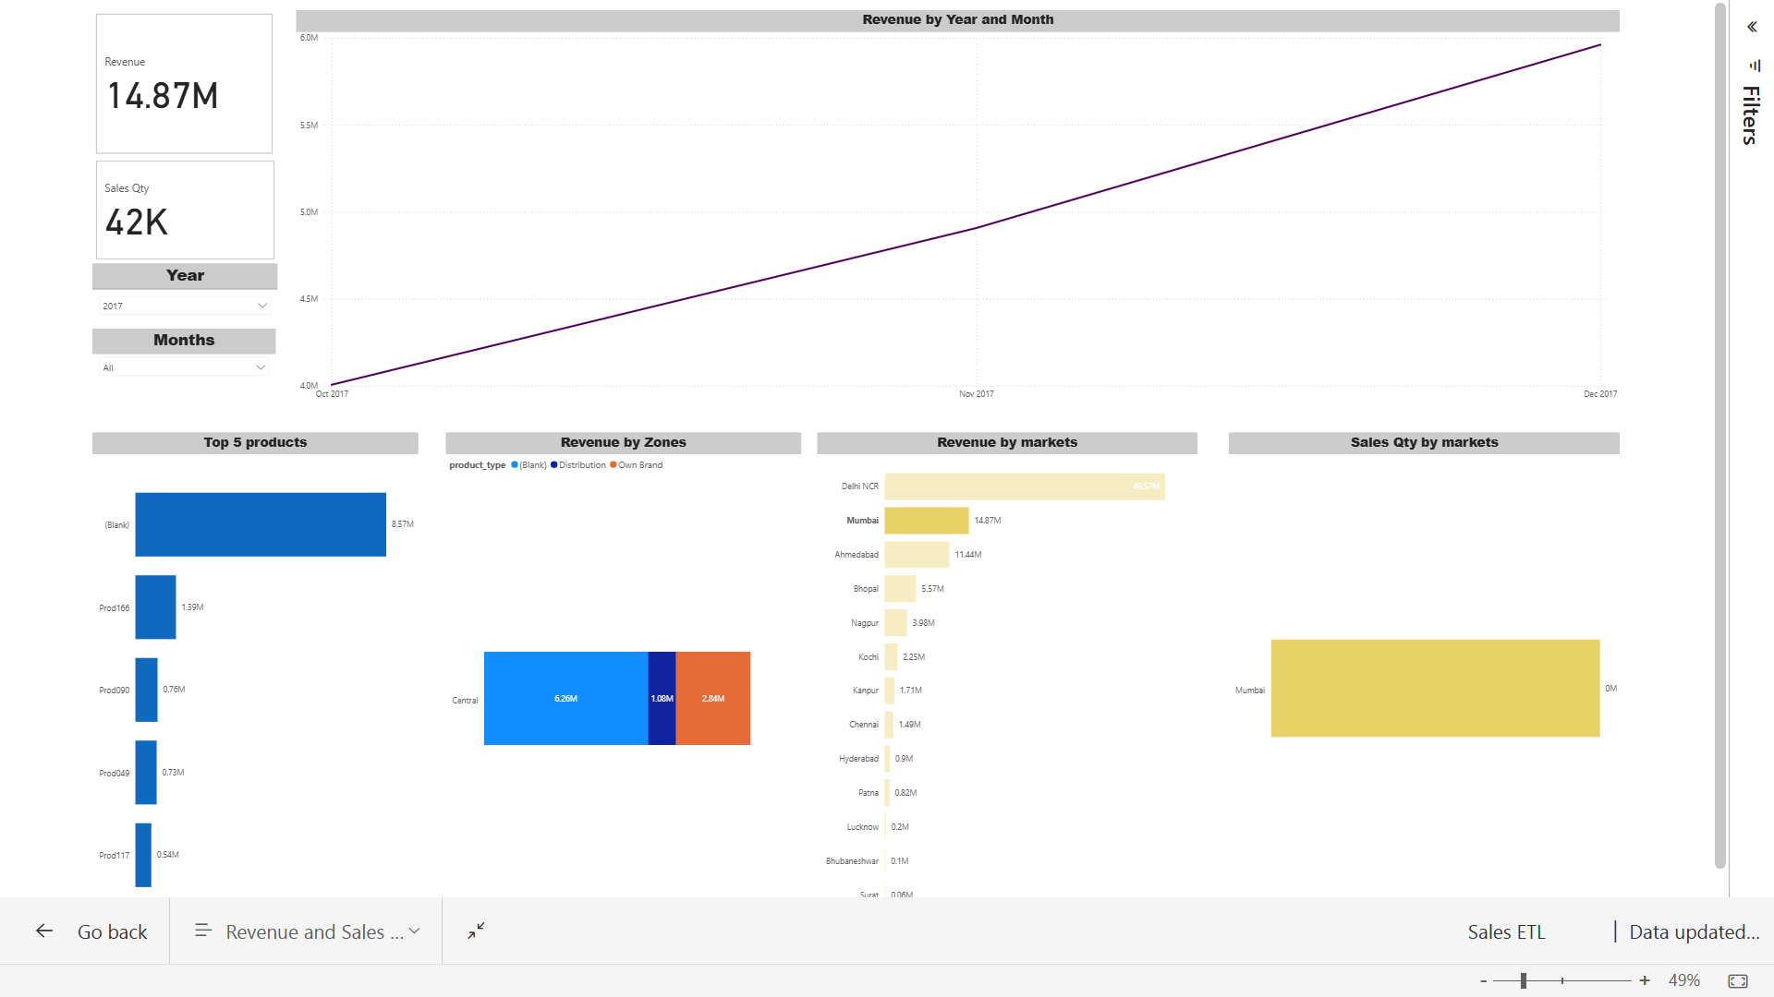

Slide 11

THANK YOU

